Slide 1
MACHINE LEARNING
Manshubh, Tribhi, Sahil
RWE Interns
21/07/2017

Slide 2
Introduction to Machine Learning
Machine learning is the subfield of computer science that, according to Arthur Samuel in 1959, gives "computers the ability to learn without being explicitly programmed.

Slide 3
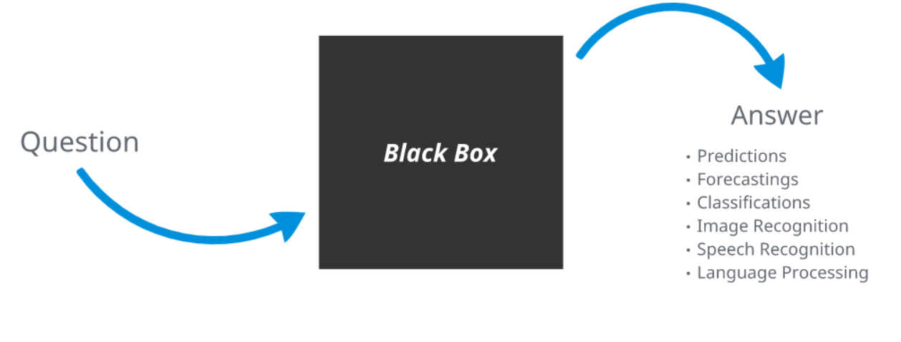
Machine

Slide 4
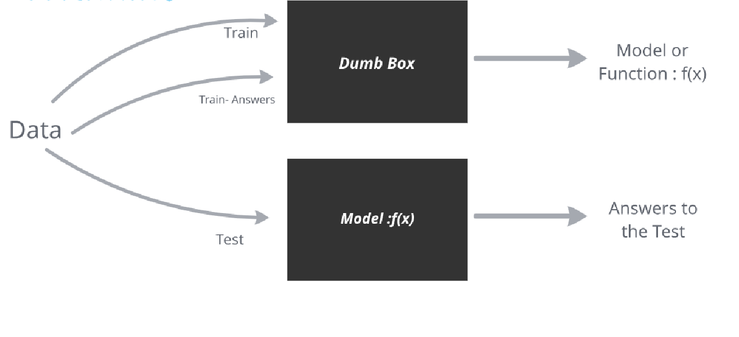
Learning

Slide 5
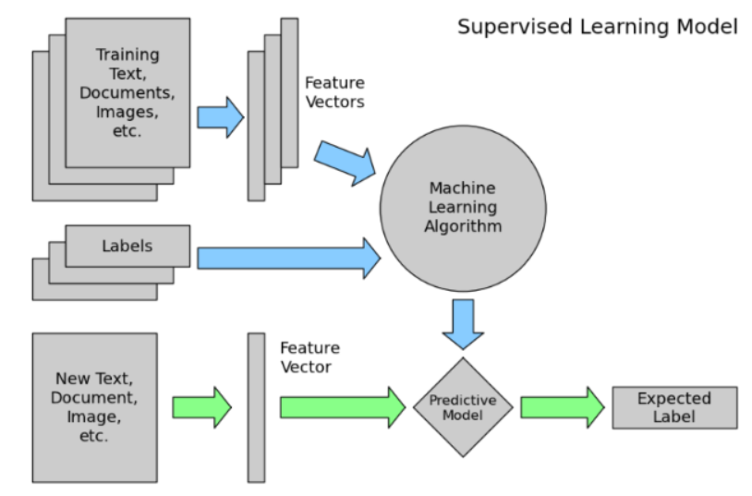
Process Of Machine Learning

Slide 6
Basic Terminology
Statistical Terminology
Classification
Regression
Model Fitting/Training

Slide 7
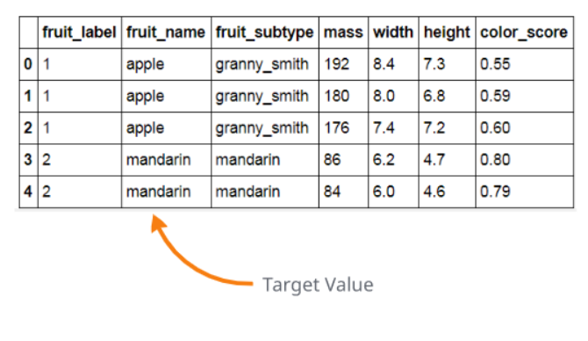
Classification Problems
Classification is a data mining function that assigns items in a collection to target categories or classes. The goal of classification is to accurately predict the target class for each case in the data.

Slide 8
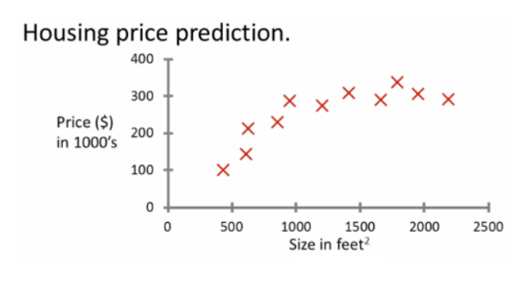
Regression problem
Regression analysis is a statistical process for estimating the relationships among variables. It includes many techniques for modeling and analyzing several variables, when the focus is on the relationship between a dependent variable and one or more independent variables (or 'predictors').The target value is a continuous value.

Slide 9
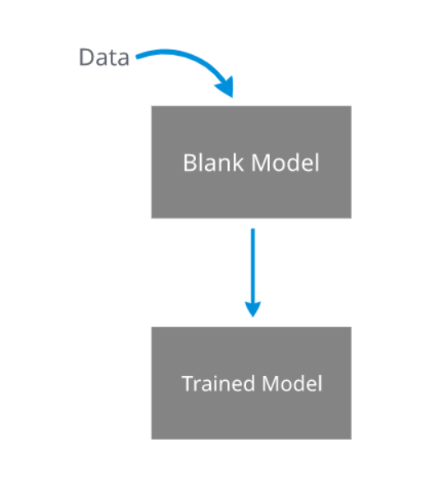
Model Fitting/Training
Model fitting or training is a 3 steps process:First, you need a function that takes in a set of parameters and returns a predicted data set.Second, you need an 'error function' that provides a number representing the difference between your data and the model's prediction for any given set of model parameters. Third, you need to find and weight the parameters such that it minimizes this difference or error.

Slide 10
Algorithms
K Nearest Neighbors
Support Vector Machines
RegressionsDecision Trees
Random Forests
Boosting Algorithms (XGBoost)
Deep Learning (Neural Networks)
A lot more.

Slide 11
K-nearest neighbors
KNN is a very simple Machine Learning algorithm that can be used for both classification and regression problems. The basic idea is any element in a feature space is same as its "K-Nearest Neighbors"

Slide 12
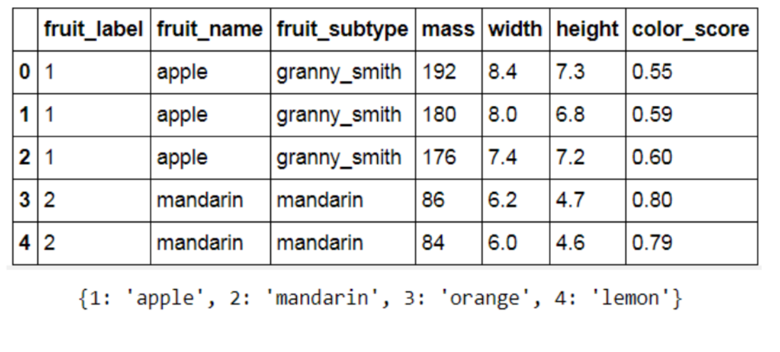
Example Dataset

Slide 13
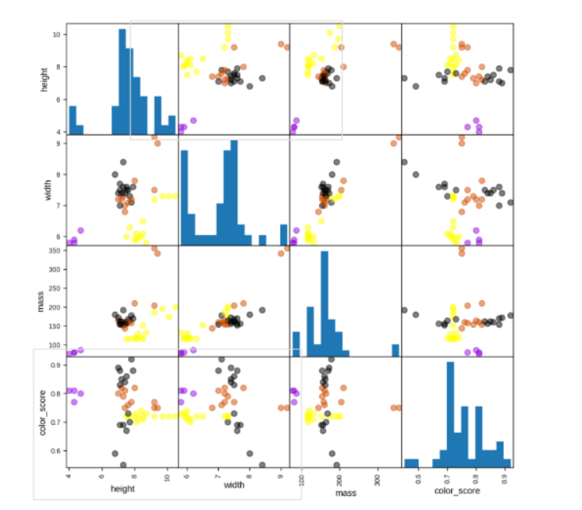
Understanding The Data

Slide 14
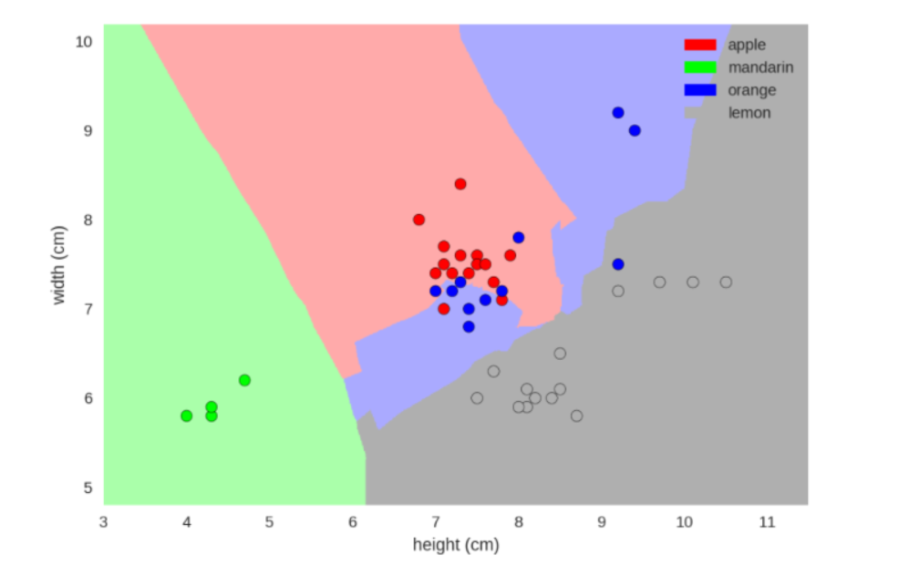
5 Nearest neighbors

Slide 15
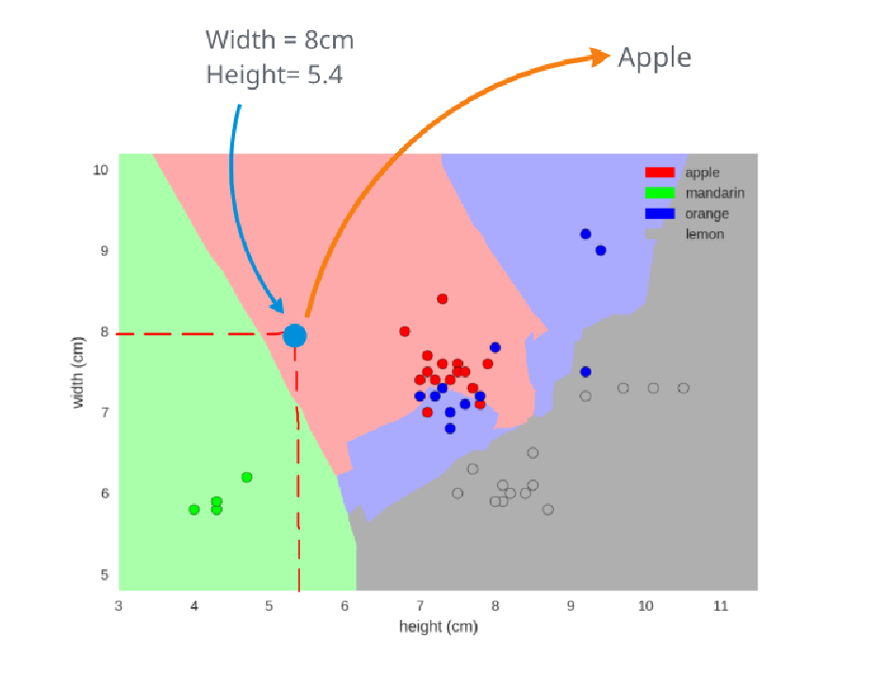
Lets Predict

Slide 16
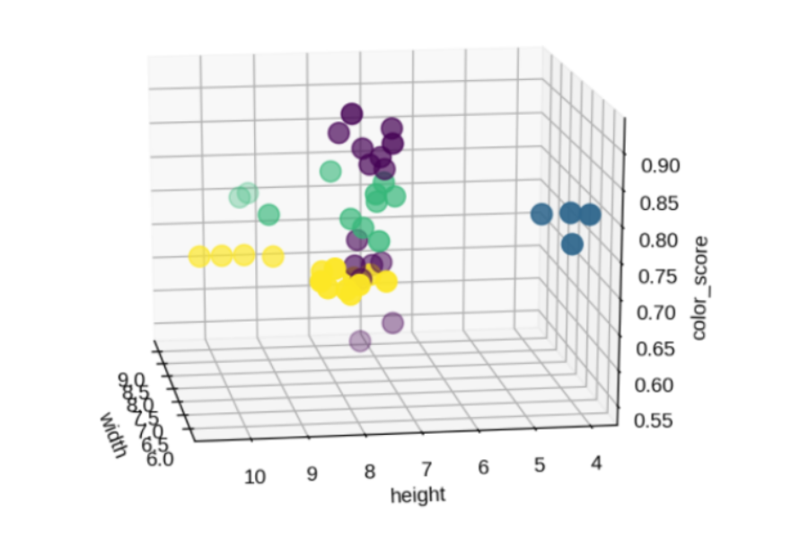
Our Limits To dimensions

Slide 17
Breast Cancer Study
The dataset set for this study was obtained from a breast cancer dataset obtained in a research carried out by University of Wisconsin, Madison.

Slide 18
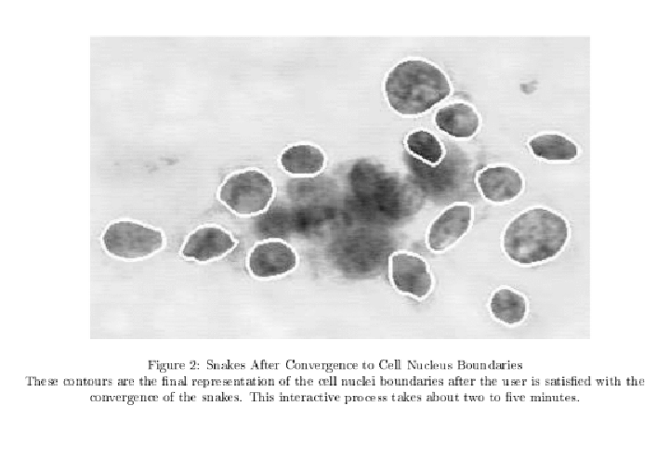
Original Study
Interactive image processing techniques, along with a linear-programming-based inductive classiffer, were used to create a highly accurate system for diagnosis of breast tumors. A small fraction of a fine needle aspirate slide was selected and digitized. With an interactive interface, the user initializes active contour models, known as snakes, near the boundaries of a set of cell nuclei. The customized snakes are deformed to the exact shape of the nuclei.

Slide 19
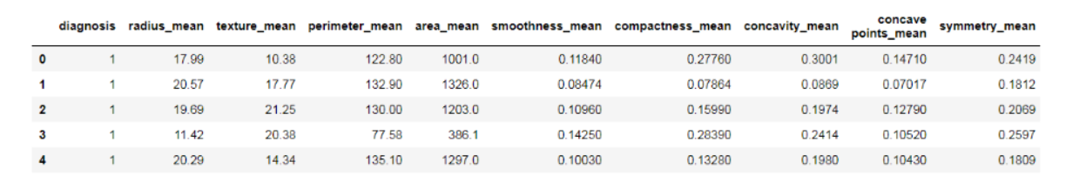
Dataset
Ten features computed by the analysis are:
Radius
Perimeter
Area
Compactness
Smoothness
Concavity
Concave Points
Symmetry
Fractal Dimensions
569 images were analyzed, different combinations of features were tested and were used for predictive analysis with an accuracy of 97%
The same feature set has also been utilized in the much more difficult task of predicting distant recurrence of malignancy in patients, resulting in an accuracy of 86%

Slide 20
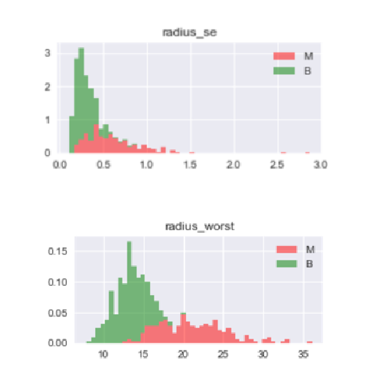
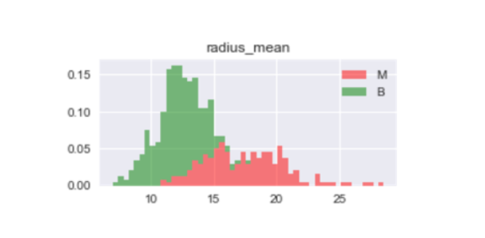
Feature Selection
Out of the 30 features obtained from the dataset, only the features giving the mean value of the dimensions were used, as they were seen to be able distinguish benignity and malignity of the samples

Slide 21
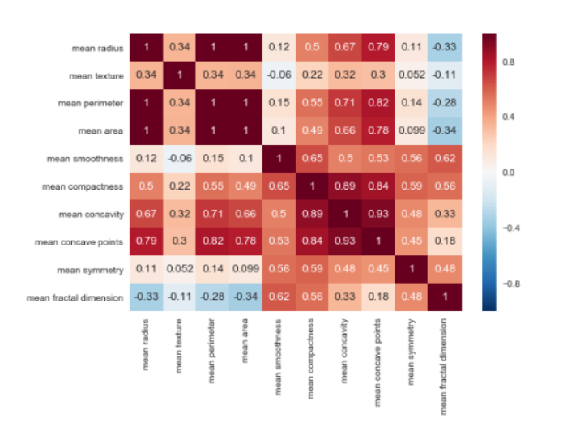
Feature Selection
The Features; Mean Radius, Mean Area and Mean Perimeter were found to be perfectly correlated. Thus, only Mean Radius has been used in this study to eliminated redundant information from analysis.

Slide 22
SVM
Support Vector Machines

Slide 23
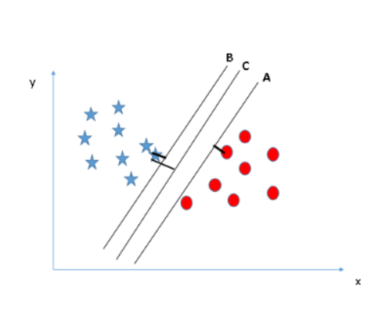
Introduction
A support vector machine algorithm constructs a hyperplane or set of hyperplanes in a high- or infinite-dimensional space, which can be used for classification and even regression.
It is usually used as a classifier.
In this algorithm, we plot each data item as a point in n-dimensional space (where n is number of features you have) with the value of each feature being the value of a particular coordinate.
Then, we perform classification by finding the hyper-plane that differentiate the two classes very well

Slide 24
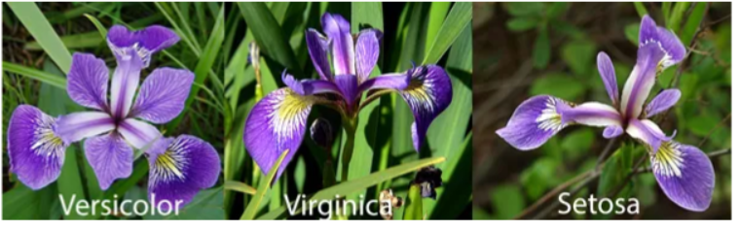
Example dataset
This famous classification dataset first time used in Fisher’s classic 1936 paper, The Use of Multiple Measurements in Taxonomic Problems. Iris dataset is having 4 features of iris flower and one target class.
The 4 Features are:-
- Sepal Length(cm)
- Sepal Width(cm)
- Petal Length(cm)
Petal Width(cm)
The target class :
- Setosa
- Versicolor
Virginica

Slide 25
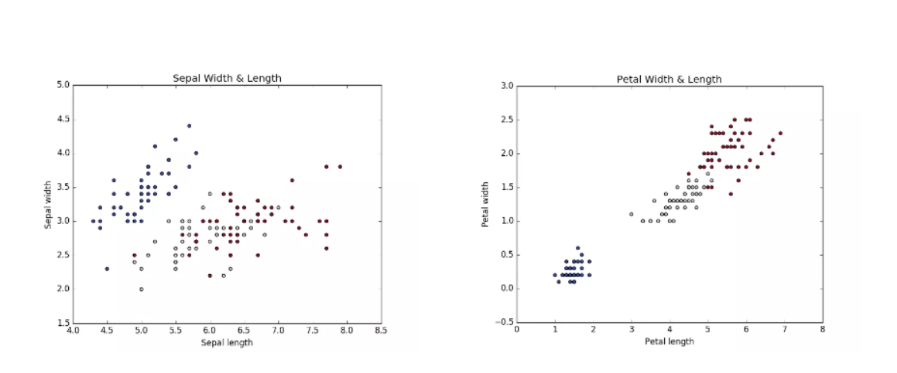
Data Distribution

Slide 26
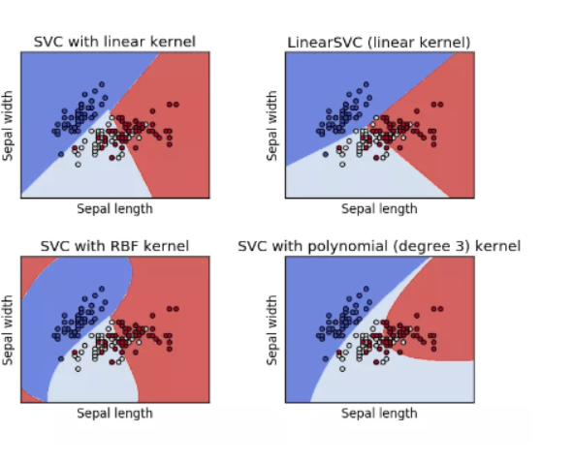
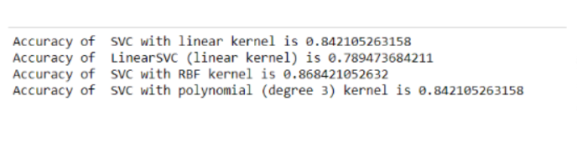
Results on Example Dataset
When classified only using two features namely Sepal Length and Sepal width the classification boundaries and accuracy obtained are thus obtained:

Slide 27
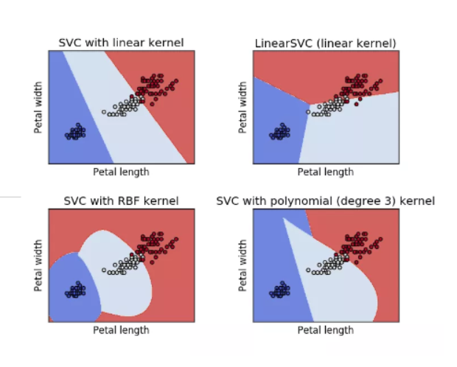
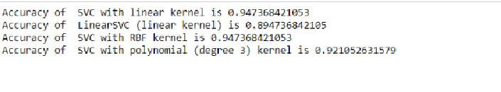
Results on Example Dataset
When the Petal Length and Petal width were used for classification, the accuracy and the decision boundaries so obtained are given. As expected from the distribution graphs, the results obtained from this study are better than the previous.

Slide 28
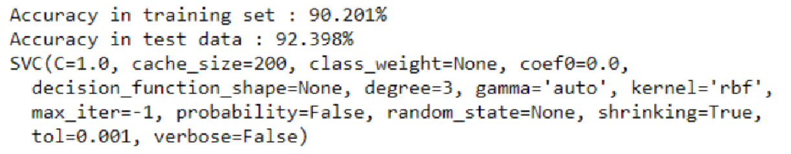
RESULTS ON BREAST CANCER DATASET

Slide 29
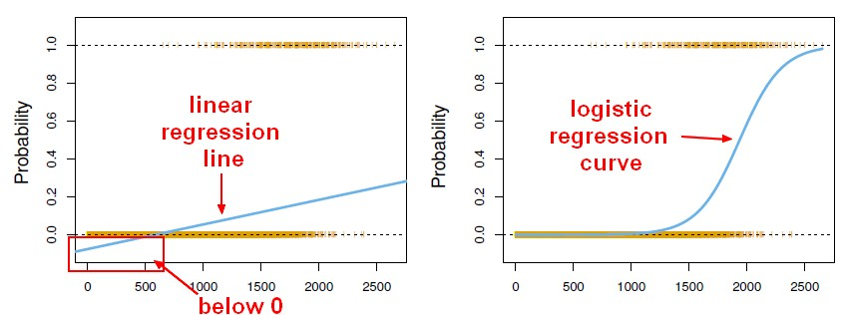
REGRESSION
Linear Regression Logistic Regression

Slide 30
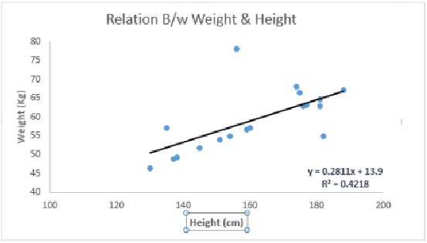
LINEAR REGRESSION
MODEL EQUATION:
Y = β0 + β1*X
EXAMPLE
Arrange people in increasing order of
their weights, without asking their weights.
These coefficients β0 and β1 are derived based on minimizing the sum of squared difference of distance between data points and regression line.

Slide 31
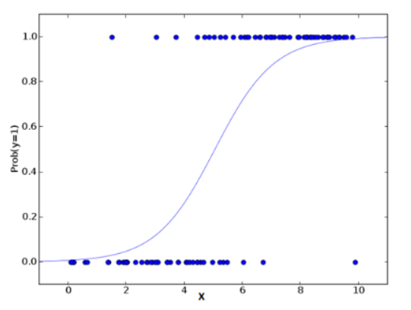
LOGISTIC REGRESSION
It is a classification not a regression algorithm. It is used to estimate discrete values ( Binary values like 0/1, yes/no, true/false ) based on given set of independent variable(s).
In simple words, it predicts the probability of occurrence of an event by fitting data to a logit function.

Slide 32
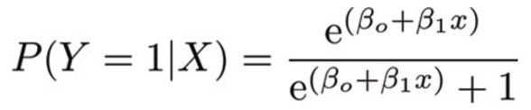
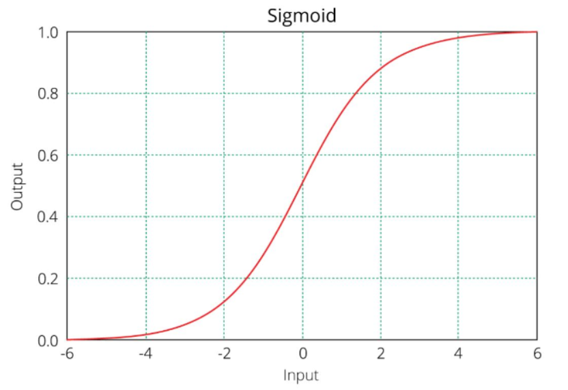
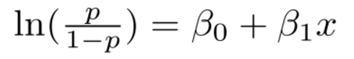
LOGISTIC FUNCTION

Slide 33
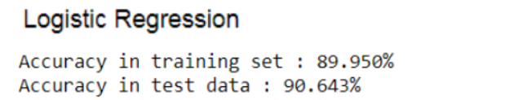
ACCURACY SCORE ON DATASET

Slide 34
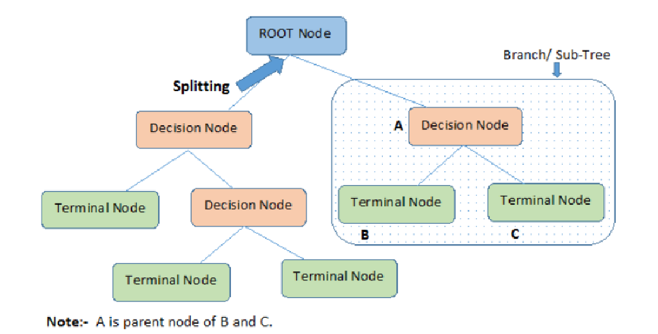
DECISION TREES
A supervised learning algorithm, mostly used in classification problems.
In this technique, we split the population or sample into two or more homogeneous sets (or sub-populations) based on most significant splitter / differentiator in input variables.

Slide 35
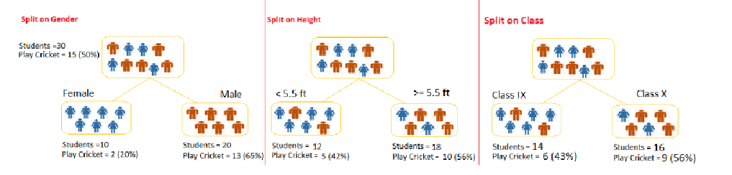
EXAMPLE
We have a sample of 30 students with three variables Gender (Boy/ Girl), Class( IX/ X) and Height (5 to 6 ft). 15 out of these 30 play cricket in leisure time. Now, I want to create a model to predict who will play cricket during leisure period?

Slide 36
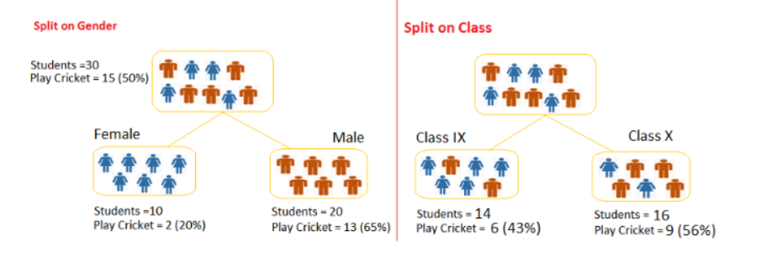
GINI INDEX
The decision of making strategic splits heavily affects a tree’s accuracy. Decision tree splits the nodes on all available variables and then selects the split which results in most homogeneous sub-nodes.

Slide 37
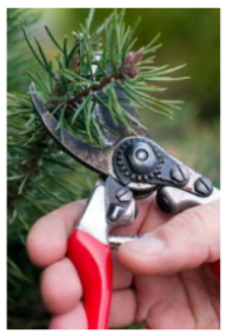
TREE PRUNING
In this algorithm, the decision for splitting will be made by checking for the best split instantaneously and moving forward until one of the specified stopping condition is reached. Hence, the technique of setting constraint is a greedy-approach.
We first make the decision tree to a large depth. Then we start at the bottom and start removing leaves which are giving us negative returns when compared from the top.

Slide 38
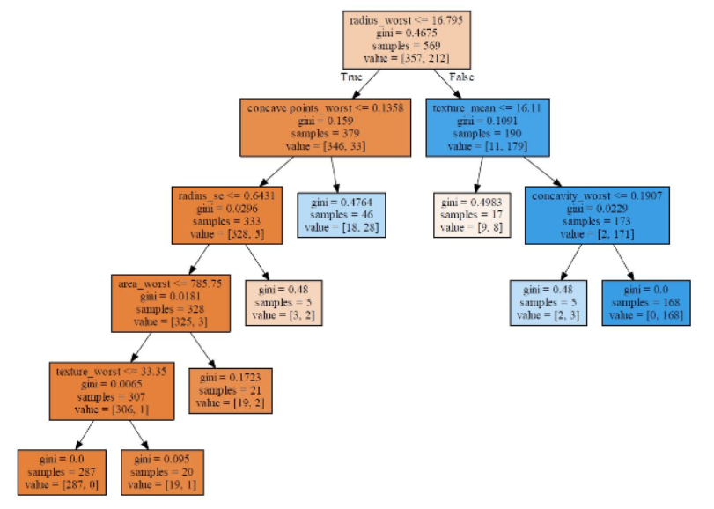
DATASET

Slide 39
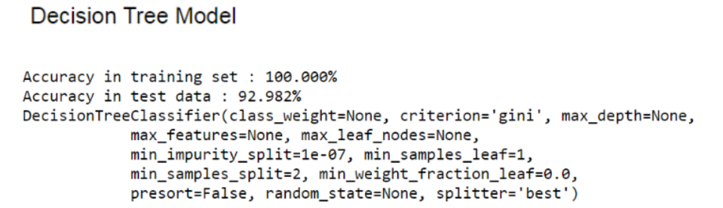
ACCURACY SCORE

Slide 40
RANDOM FOREST
A versatile machine learning method capable of performing both regression and classification tasks.
It is a type of ensemble learning method, where a group of weak models combine to form a powerful model.

Slide 41
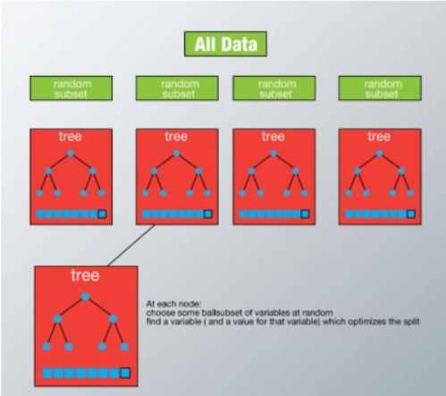
HOW IT WORKS?
We grow multiple trees as opposed to a single tree.
Each tree is grown to the largest extent possible and there is no pruning.
To classify a new object based on attributes, each tree gives a classification and we say the tree “votes” for that class. The forest chooses the classification having the most votes. The combined values are generally more robust than a single model.

Slide 42
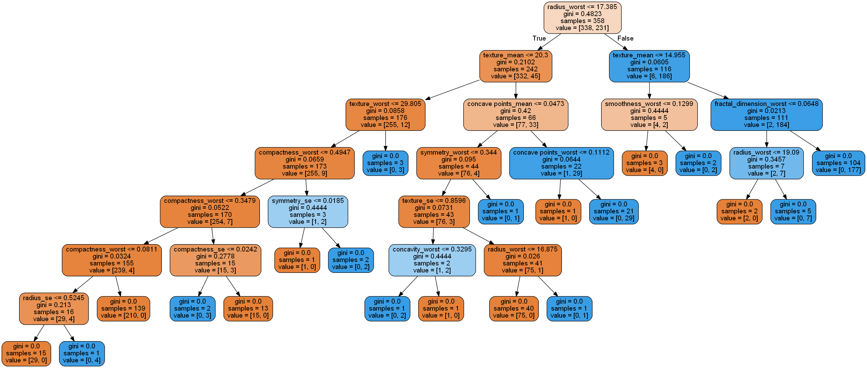
WHEN IMPLEMENTED ON DATASET

Slide 43
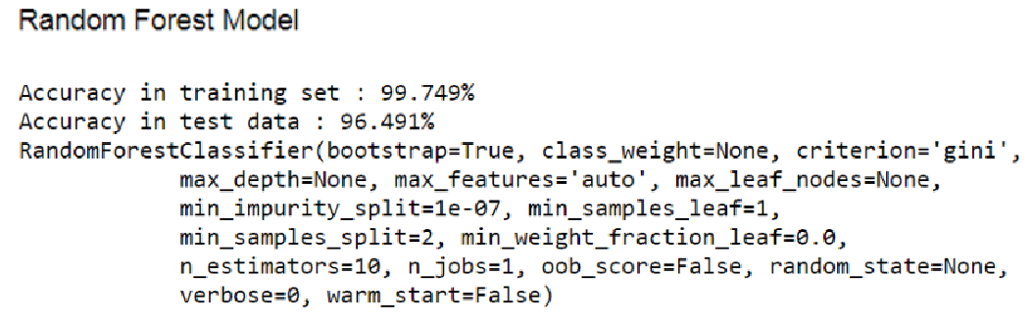
ACCURACY SCORE ON DATASET

Slide 44
ANN
Artificial Neural Networks

Slide 45
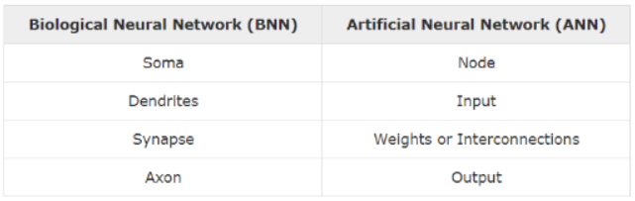
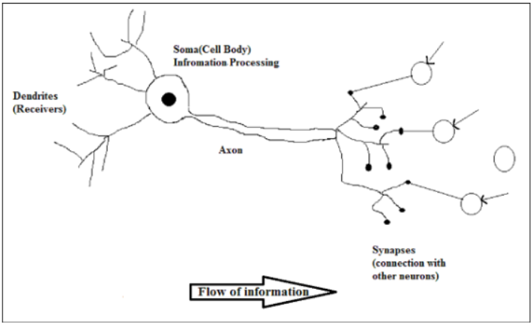
HEURISTIC PERPECTIVE
The key to Artificial Neural Networks is that their design enables them to process information in a similar way to our own biological brains, by drawing inspiration from how our own nervous system functions. This makes them useful tools for solving problems like facial recognition, which our biological brains can do easily.

Slide 46
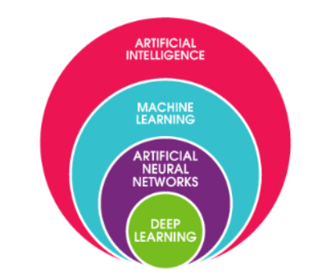
DEEP LEARNING
Deep Learning through Neural Network and takes us a step closer to Artificial Intelligence. Features of the ANN that qulafies it as 'deep' algorithm are: Hidden layers of multiple neural networks.
Effectively handles non-linearities.
Higher level of abstraction.
Algorithms like Decision Trees, SVM, Naive Bayes are ‘shallow’ algorithm. These involves writing lot of duplicated code and cause trouble reusing previous computations.

Slide 47
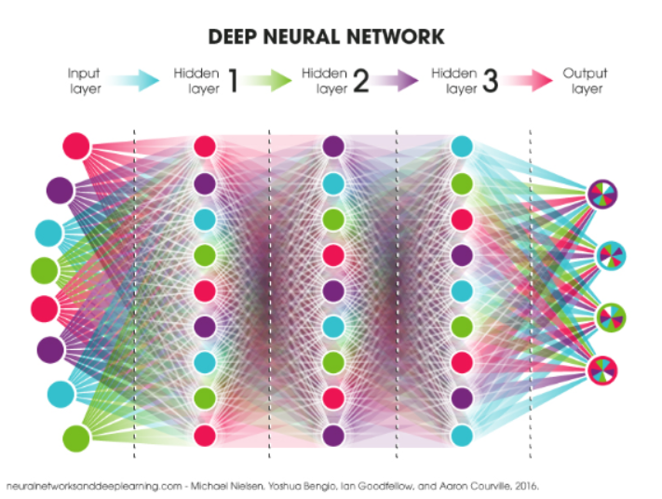
IMPLEMENTATION
The basic forming unit of a neural network is a perceptron.
The basic characteristics of a perceptron are :
Weights
Bias
Activation Function

Slide 48
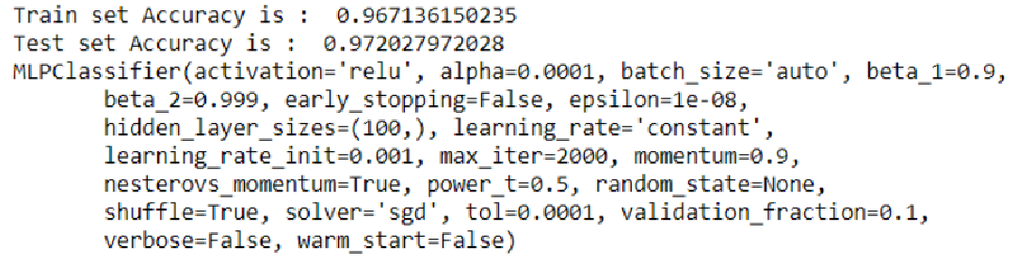
RESULTS ON BREAST CANCER DATA

Slide 49
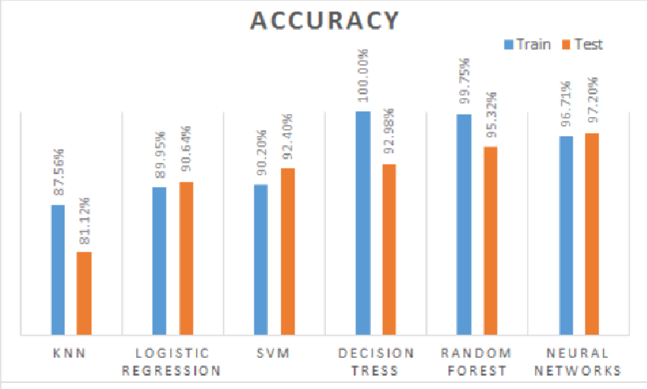
COMPARITIVE RESULTS

Slide 50
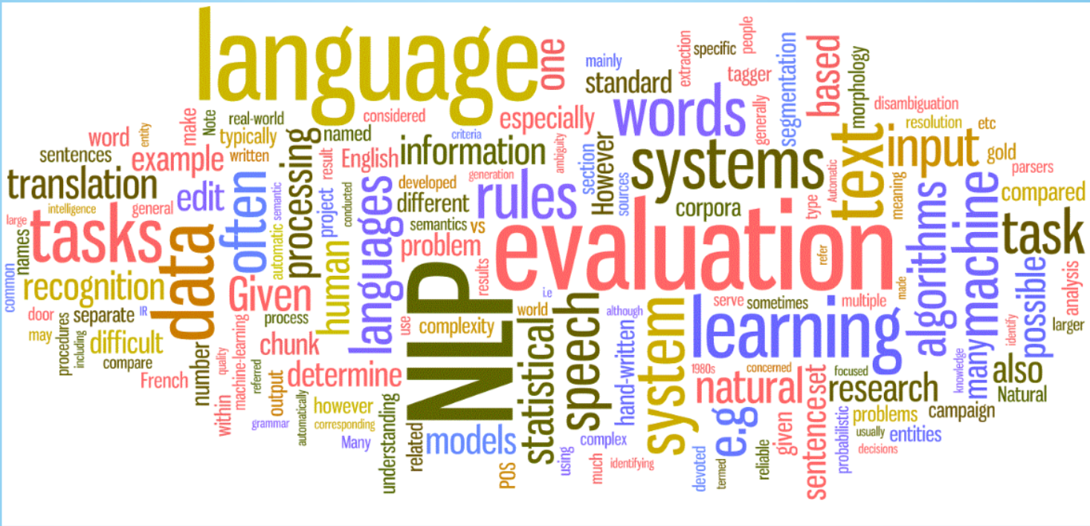
Natural Language Processing
A computer has the capability to do everything that a human has the capability to teach it.

Slide 51
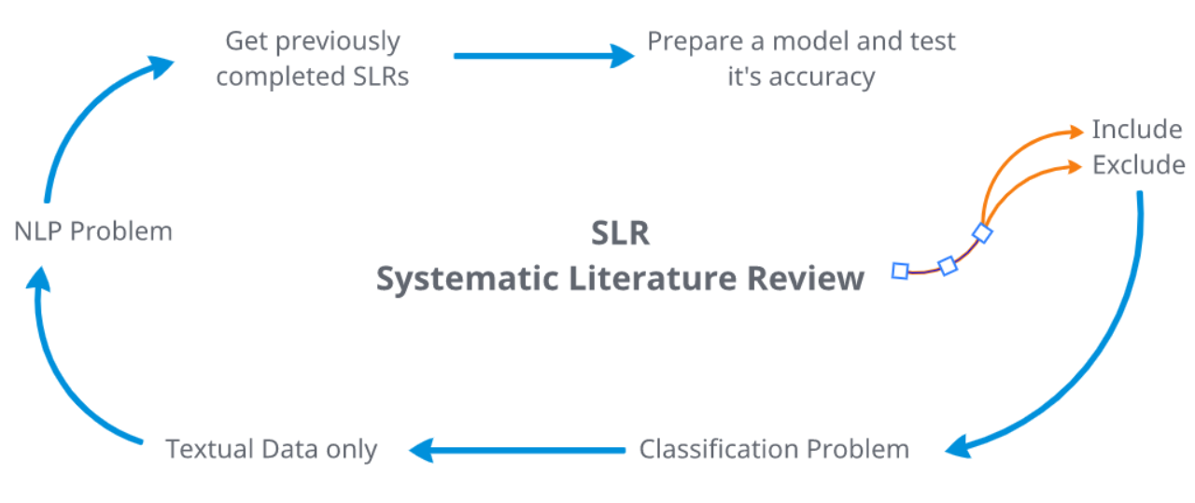
Our Inspiration

Slide 52
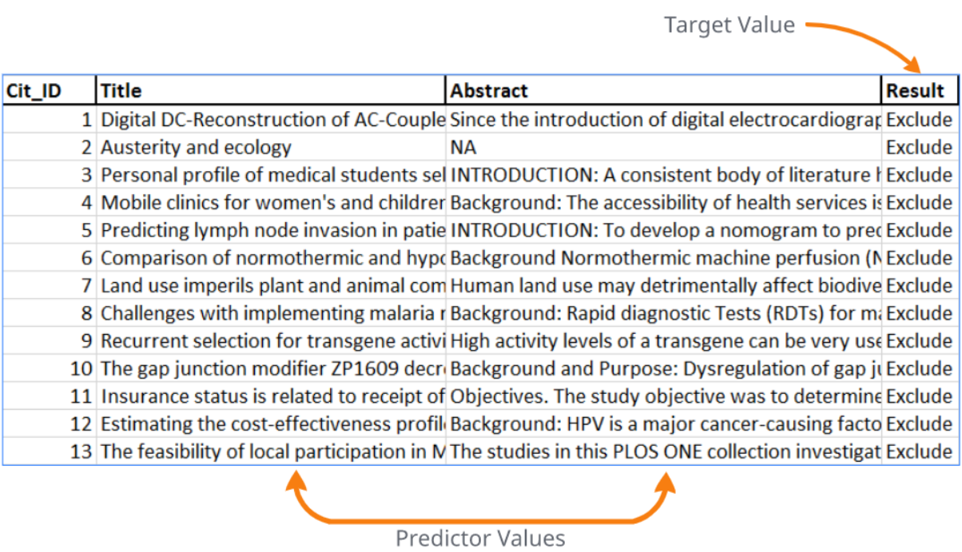
Let's create a problem

Slide 53
Text preprocessing
Preprocessing : Preparing the data to extract features out of that data
Noise Removal
Lexicon Normalization
Object Standardization

Slide 54
Noise Removal
Any piece of text which is not relevant to the context of the data and the end-output can be specified as the noise. A general approach for noise removal is to prepare a dictionary of noisy entities, and iterate the text object by tokens (or by words), eliminating those tokens which are present in the noise dictionary. This dictionary is called Stop Words.
stop_words_list = ["is", "a", "this", "..."]

Slide 55
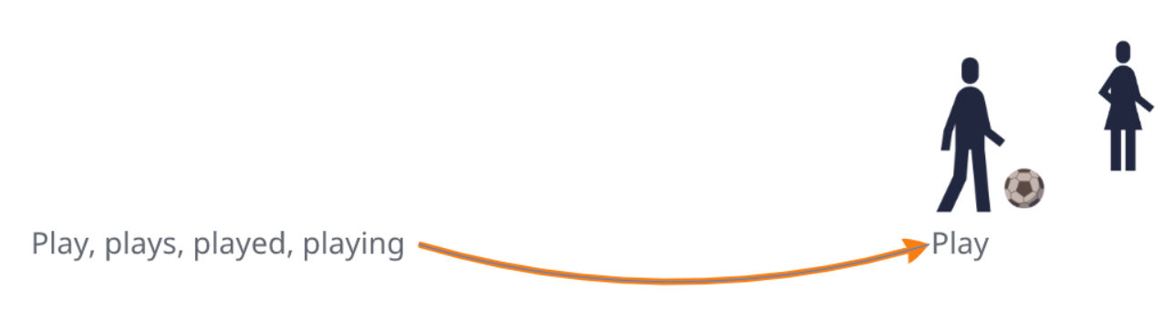
Lexicon Normalization
The multiple representations exhibited by single word.
Stemming: Stemming is a rudimentary rule-based process of stripping the suffixes (“ing”, “ly”, “es”, “s” etc) from a word.
Lemmatization: Lemmatization, on the other hand, makes use of vocabulary (dictionary importance of words) and morphological analysis (word structure and grammar relations).

Slide 56
Object Standardization
Text data often contains words or phrases which are not present in any standard lexical dictionaries. These pieces are not recognized by search engines and models.
lookup_dict = {'rt':'Retweet', 'dm':'direct message', "awsm" : "awesome", "luv" :"love", "..."}
This was something we skipped because different article authors might have different styles and a common list was quite difficult to make.

Slide 57

Lets Learn from Train Data (Epidemiology)
66% of data was used as our train Data Set and for all the Vocabulary use we found the TFIDF Vectors or values. For both Abstract and Title vocabulary included we had 8428 features in total.

Slide 58

Logistic Regression

Slide 59

Not Every Data is Simple
Non-Small-Cell Lung Cancer
Running a model blindly without understanding the data gave us an accuracy of only 68.9%
Solution : Let's learn from our mistakes.

Slide 60

Lets look at the False Predictions
Out of a total of 620 predictions 169 were FALSE

Slide 61

Empty Abstracts?
Talking to our seniors we found that majority of Empty abstracts are included.
Considering the empty abstract Criteria we have only 32 FALSE predictions that gives us an error of 5.16% or an accuracy of 94.83%.

Slide 62
USES
To do a quality check of your work.
To do half the work and let machine do the other half.
To prepare Models on previously done SLRs so future SLRs on same topic can be automated
Add more features and conditions by experienced people in the field of SLR to prepare a generalized model to improve generalized accuracy.

Slide 63


